Slide 1
Development of an E-commerce Sales Chatbot
ASK MART
Submitted by: Prasad Zoman
Role: Full Stack Intern Applicant
Event: June 2025 Internship Case Study Submission

Slide 2
Introduction
Ask Mart is a simulated e-commerce platform specializing in textiles.
Objective: Build a responsive, intelligent chatbot for product. discovery.
Features:
Natural language query parsing
Integration with React frontend & Flask backend
Uses MySQL to store product data

Slide 3
System Architecture
Frontend (React.js): Chatbot interface, product display
Backend (Flask): REST APIs for auth, chatbot, and product data
Database (MySQL): Stores 100+ mock product entries
Include a labeled architecture flow diagram

Slide 4
System Architecture
Layer | Technology | Justification
Frontend | React.js | Modular, SPA capabilities
Backend | Flask | Lightweight, Python-compatible
Auth | Flask-Login | Easy session and auth management
CORS | Flask-CORS | Solves cross-origin issues
Database | MySQL | Structured relational management
Tools | Postman, GitHub | API testing and version control

Slide 5
Backend Implementation
RESTful endpoints:/signup, /login, /logout, /me/chatbot/query.
Query:
{
"message": "Show me shirts under ₹800”
}
Response returns filtered products with name, price, and links

Slide 6
Frontend Interface
Built with React.js
Features:
Login/Sign-up with validation
Chatbot with timestamps & reset
Responsive product cards
Mobile/tablet/desktop compatibility

Slide 7
Mock Data Creation
MySQL populated with 100+ products
Product fields: id, name, category, price, description, stock, image_url
Tools used:
ChatGPT for data generation
fakestoreapi for images

Slide 8
Sample Queries & Results
Query | Parsed Filters | Results
Cotton shirts under 800 | category: shirts, price<800 | 5 matching items
SSD above 1000 | category: SSD, price>1000 | 3 matching items

Slide 9
Challenges & Solutions
Challenge | Solution
CORS issues | Configured Flask-CORS with credentials
Session cookies lost | Enabled withCredentials in Axios
Matching queries to filters | Used keyword-based rule parsing
Generating realistic inventory | Mixed ChatGPT and fakestoreapi data

Slide 10
Mock Data Creation
Conclusion:
Efficient chatbot for product discovery
Uses modern web stack with rule-based NLP
Future Improvements:
NLP with spaCy/GPT
Voice input support
Payment simulation
User profiles and multi-category support

Slide 11
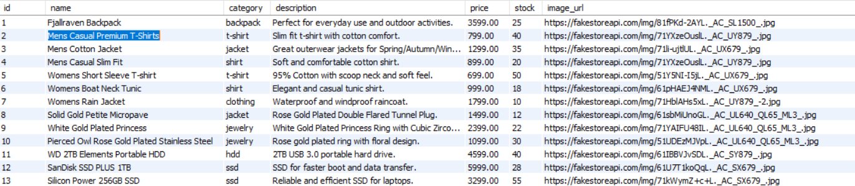
Database Screenshot

Slide 12
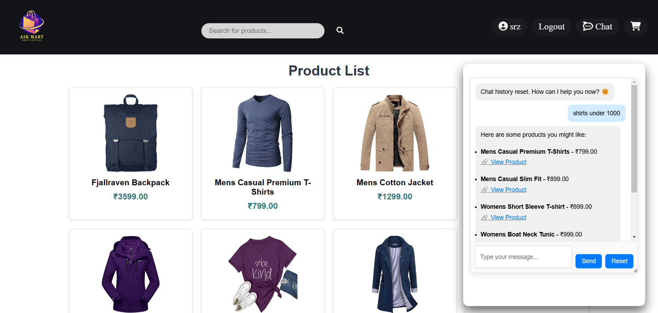
Chatbot Screenshot

Slide 13
THANK YOU

